Slide 1
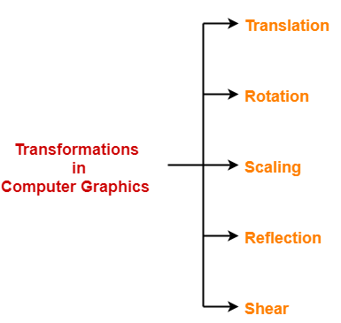
Transformation Techniques
In computer graphics, various transformation techniques are:

Slide 2
2-Dimensional Transformations
The Basic Transformations:
Translation
Scaling
Rotation
Other Transformations:
Reflection
Shearing

Slide 3
Translation
Displacement of an object in a given distance and direction from its original position.
Rigid body transformation that moves object without deformation
Initial Position point P (x, y)
The new point P’ (x’, y’)
where x’ = x + tx , y’ = y + ty , tx and ty is the displacement in x and y respectively.

Slide 4
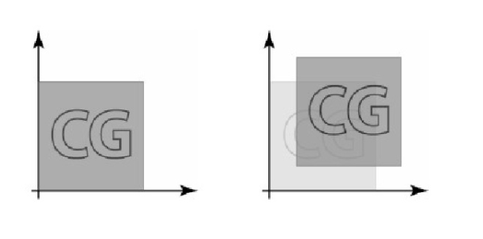
Translation

Slide 5
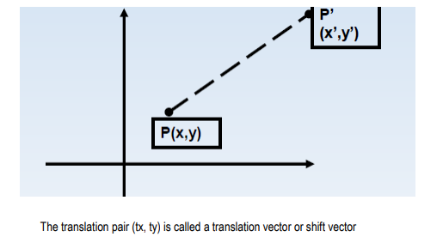
Translation

Slide 6
Example: Translation
Assume you are given a point at (x,y)=(2,1). Where will the point be if you move it 3 units to the right and 1 unit up?
Ans: (x',y') = (5,2).
How was this obtained? - (x',y') = (x+3,y+1)

Slide 7
Translation
A translation can also be represented by a pair of numbers, t=(tx,ty) where tx is the change in the x-coordinate and ty is the change in y coordinate. To translate the point p by t, we simply add to obtain the new (translated) point.

Slide 8
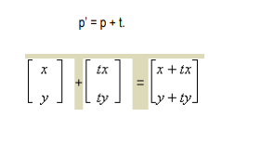
Translation

Slide 9
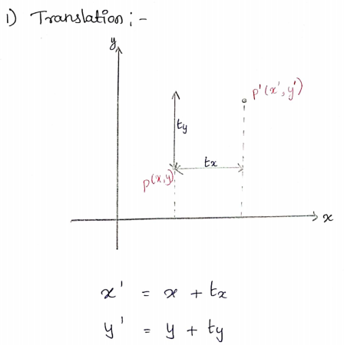

Slide 10
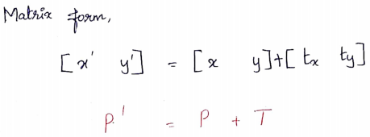
Translation

Slide 11
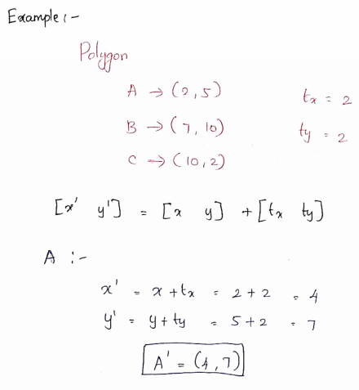
Example: Translation

Slide 12
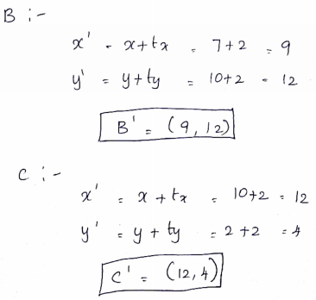
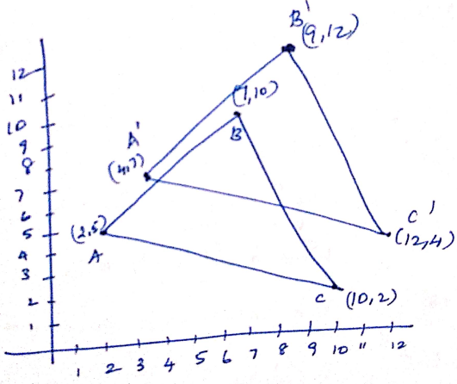
Example: Translation

Slide 13
Rotation
Rotation is applied to an object by repositioning it along a circular path in the xy plane.
To generate a rotation, we specify
Rotation angle θ
Pivot point ( xr , yr)
Positive values of θ for counterclockwise rotation. Negative values of θ for clockwise rotation.

Slide 14
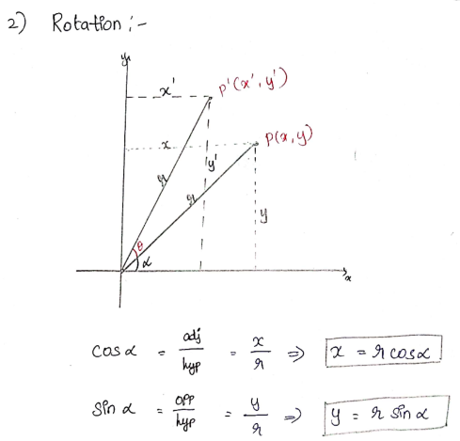
Rotation

Slide 15
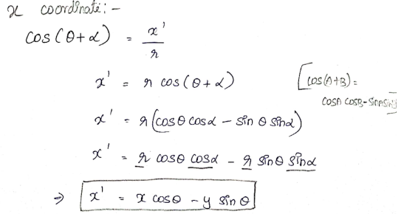
Rotation

Slide 16
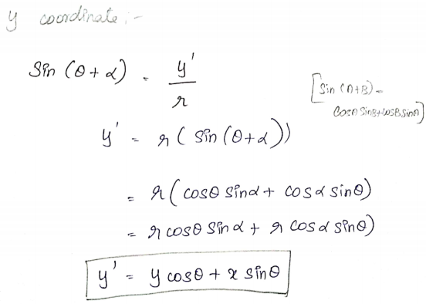
Rotation

Slide 17
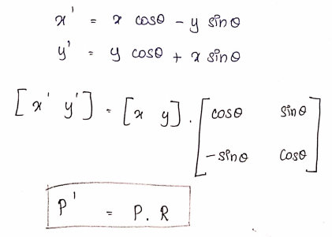
Rotation

Slide 18
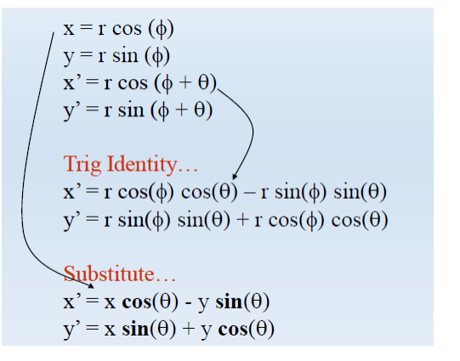
Rotation

Slide 19
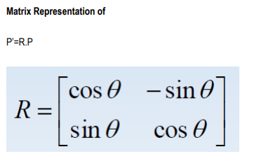
Rotation

Slide 20
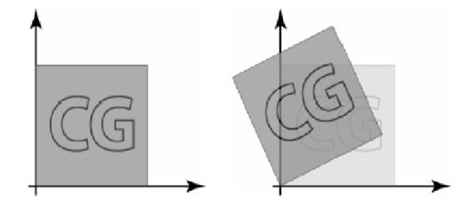
Rotation

Slide 21
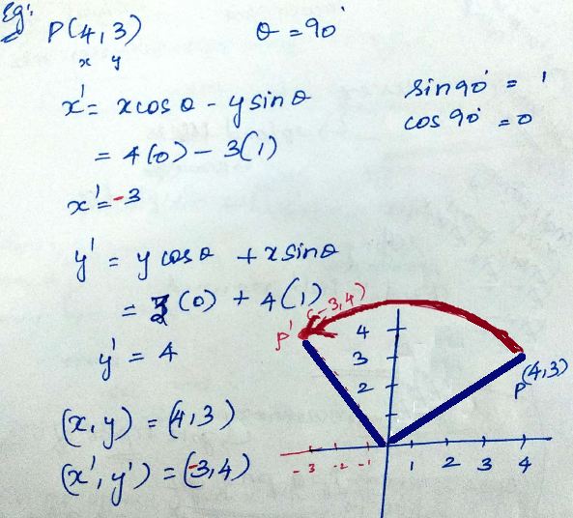
Example: Rotation

Slide 22
Scaling
Scaling alters the size of an object.
Operation can be carried out by multiplying each of its components by a scalar
Uniform scaling means this scalar is the same for all components
Non-uniform scaling: different scalars per component
x’ = x* sx
y’ = y * sy

Slide 23
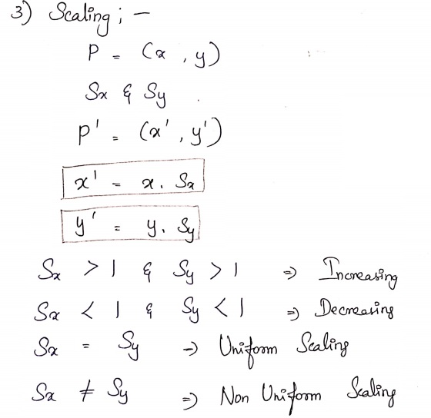
Scaling

Slide 24
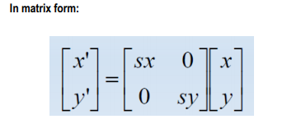
Scaling

Slide 25
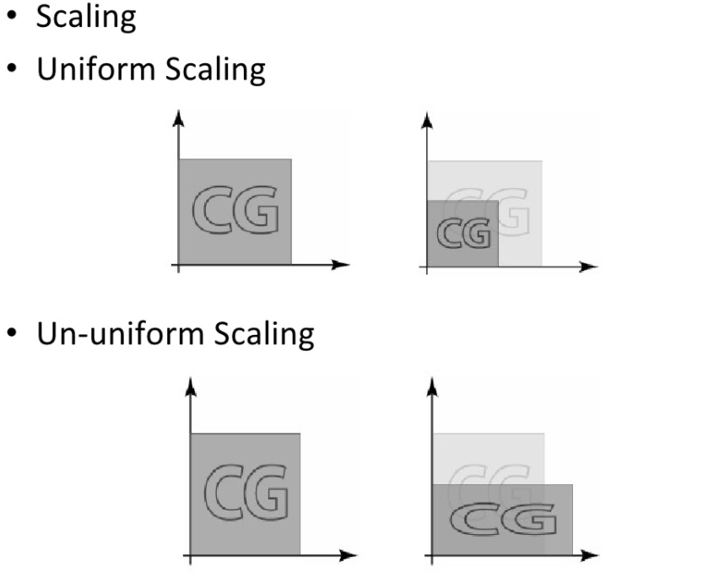

Slide 26
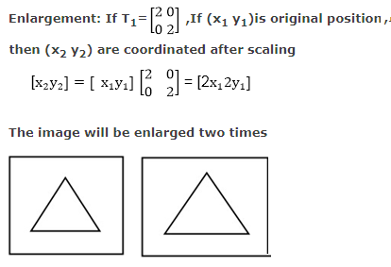
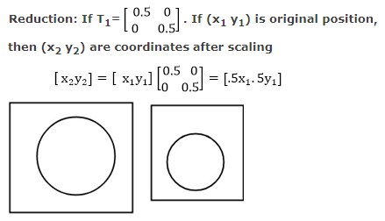
Example: Scaling

Slide 27
Reflection
A reflection is a transformation that produces a mirror image of an object generated relative to an axis of reflection
Reflection along x axis
Reflection along y axis
Reflection relative to an axis perpendicular to the xy plane and passing through the coordinate origin
Reflection of an object relative to an axis perpendicular to the xy plane and passing through point P
Reflection of an object with respect to the line y=x.

Slide 28
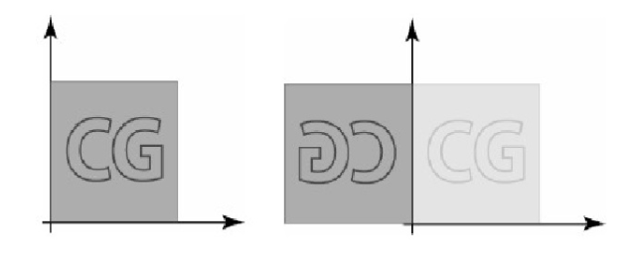
Reflection

Slide 29
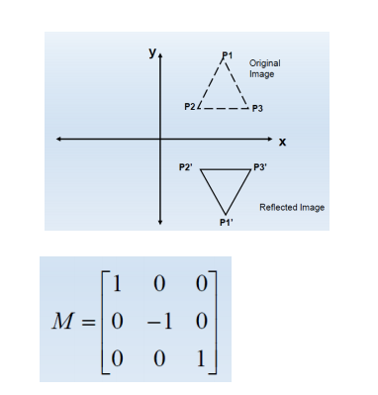
Reflection about x-axis:

Slide 30
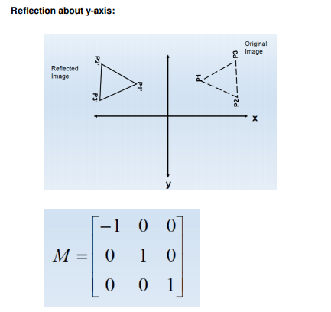
Reflection about y-axis:

Slide 31
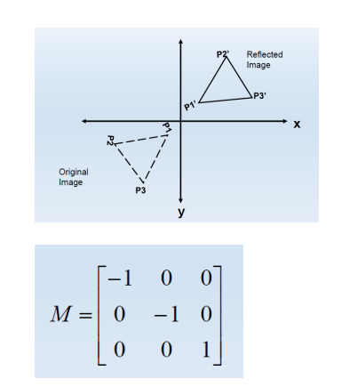
Reflection relative to an axis perpendicular to the xy plane and passing through the coordinate origin:

Slide 32
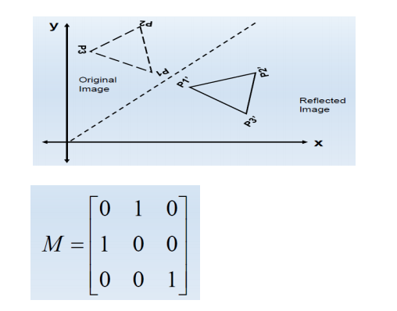
Reflection of an object with respect to the line y=x

Slide 33
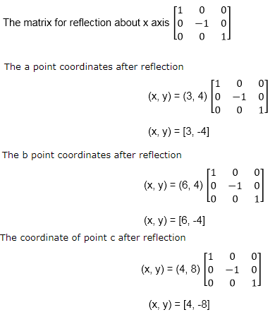
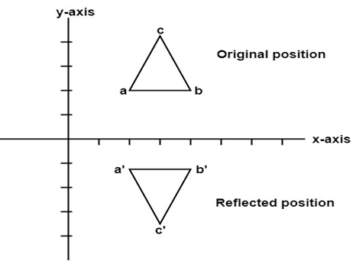
Example: Reflection
A triangle ABC is given. The coordinates of A, B, C are given as
A (3 4) B (6 4) C (4 8)
Find reflected position of triangle i.e., to the x-axis.

Slide 34
Example: Reflection
a (3, 4) becomes a` (3, -4) b (6, 4) becomes b` (6, -4) c (4, 8) becomes c` (4, -8)

Slide 35
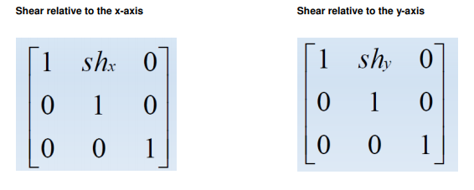
Shearing
A transformation that distorts the shape of an object such that the transformed object appears as if the object were composed of internal layers that had been caused to slide over each other.

Slide 36
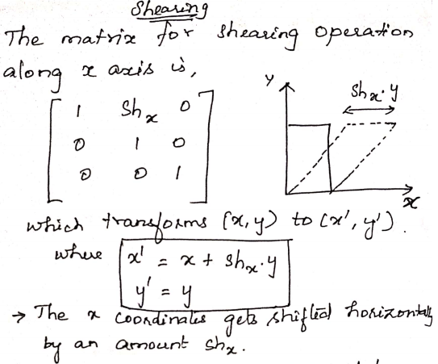
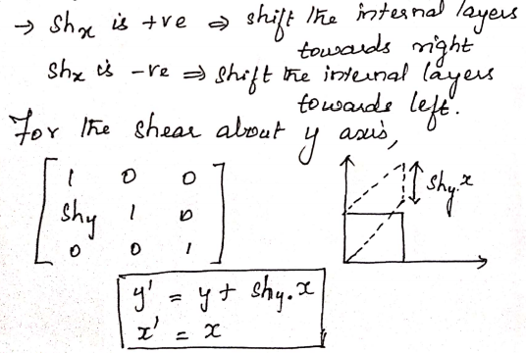
Shearing

Slide 37
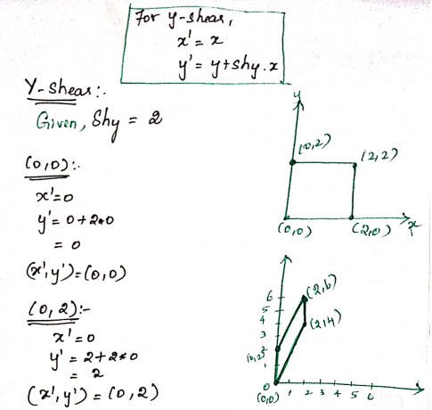
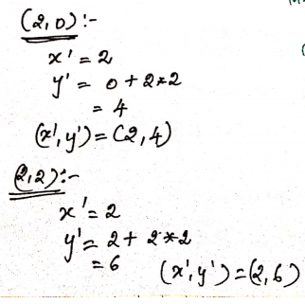
Example – Y_Shearing

Slide 38
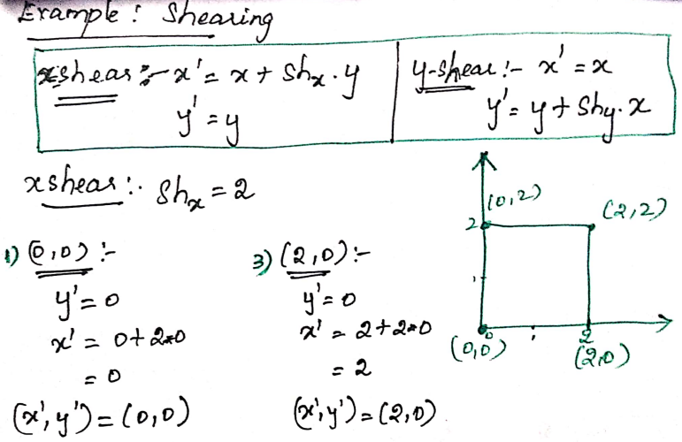
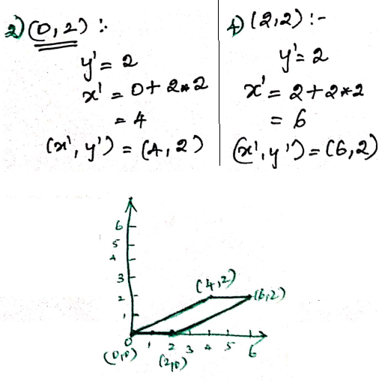
Example – X_Shearing

Slide 39
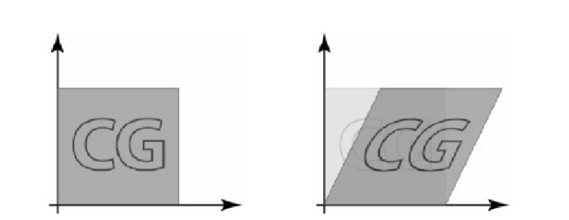
Shearing

